Slide 1

Dr.D.Y. Patil Institute of Technology, Pimpri, Pune-18 Department of Electronics and Telecommunication
TE Mini Project on
“Women’s Safety Alert Device Using Arduino”
By
Ayush Kumar Exam Seat No: T190243012
Saurabh Chavan Exam Seat No: T190243039
Shanya Mishra Exam Seat No: T190243190
Under the Guidance of
Ms. Amruta Thorat

Slide 2
OUTLINE
Introduction
Literature Survey (Findings and Drawbacks)
Problem Statement
Objectives
Block Diagram and Working
Methodology
Implementation
A) Hardware with Ckt Diagram
B) Component Specification
C) Software
Results (Hardware and proteus output)
Conclusion
Advantages/ Disadvantages
Future Scope
References

Slide 3
Introduction
Women safety in India is a big problem, Safety of women matters a lot whether at home, outside the home or working place. Areas like streets, public spaces, public transport, etc. have been the territory of women hunters. Safety of women in India is a vast topic now-a-day. We cannot say that women are safe in India by seeing the last few year crimes against women especially in the national capital. Women generally are afraid to go alone outside.
Despite of formation of various effective rules and regulations by the Indian government to handle and control the crimes against women, the number of crimes against women are increasing day by day. Rape is the most common crime against Women in India.

Slide 4
Literature Survey
In this Paper [1], the authors proposed a GPS based women’s safety system that has dual security feature. The proposed system consists of a dual alert that is buzzer and message is sent through GSM. This system can be turned on by a woman in case she even thinks she would be in trouble. This Project presents a women safety detection system using GPS and GSM modems. The system can be interconnected with the alarm system and alert the neighbors. The proposed system is complex and costlier.
In this Paper [2], the authors proposed a smart security wearable device for women based on Internet of Things. It is implemented in the form of a smart device and comprises of Arduino, Matlab based camera, buzzer and button to activate the services. A click of a button that will fetch her current location and also capture the image of the attacker via Matlab based camera. The location and the link of the GPS Values will be sent to predefined emergency contact numbers or police via smart phone of the victim.

Slide 5
In this Paper [3], the authors proposed a device that consists of an ATmega328 microcontroller, GSM module, GPS modules. The system resembles a normal device which when activated, tracks the place of the women using GPS (Global Positioning System) and sends emergency messages and call using GSM (Global System for Mobile communication), to family member and the police control room.
In this Paper [4], the authors proposed a device that consists of a trigger, microcontroller (ATmega2560), GSM module (SIM900), GPS module (Neo-6M), IoT module (ESP-12E), Neuro Stimulator, Buzzer and Vibrating Sensor. In their project, when a woman senses danger she has to hold ON the trigger of the device. Once the device is activated, it tracks the current location using GPS (Global Positioning System) and sends emergency message using GSM (Global System for Mobile communication) to the registered mobile number and nearby police station.

Slide 6
Problem Statement
India has an abhorrent track record in all forms of women insecurity. In homes, streets, public transports and even work places.
There have been grotesque cases of rapes, sexual exploitation, eve-teasing, sexual harrassments, etc.
Now, during the above mentioned happenings, out of fear one’s mind is not calm and stable.
In that case, a dedicated safety alert system could play a crucial role.

Slide 7
Objectives
We are focusing on building an effective, fast and reliant system to make the women of India feel safe and empowered.
The device will act as a 24/7 active help and companion for women so that they don’t ever feel that they are alone in the middle of a crisis situation.
This safety alert device is the execution of an idea to allow women to send an alert message to their closed ones and police with location coordinates.

Slide 8
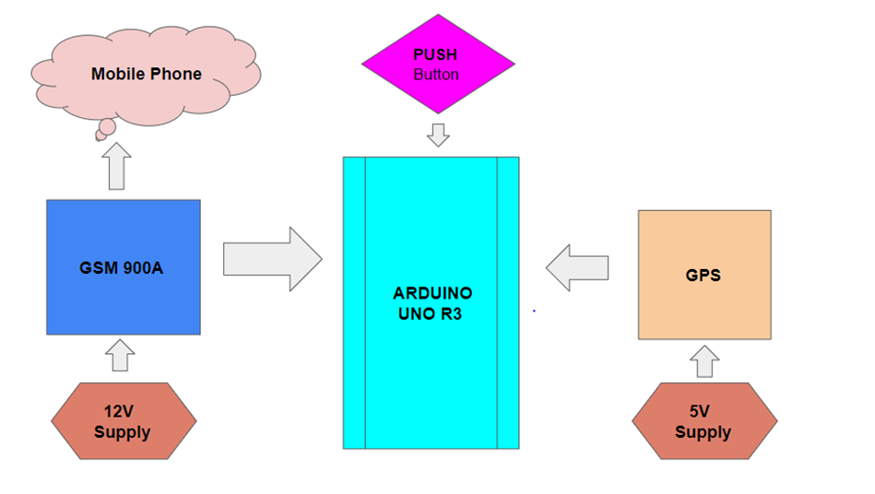
Block Diagram

Slide 9
Working
Working of this project is very simple as all the work is done by the libraries (GPS & GSM). SIM900D(GSM) is message-based communication device. GPS Module is a location monitoring device.
Push Button is connected to Digital Pin 7 and on pressing the button the response is taken as HIGH. On receiving a HIGH state, the function for sending message as well as recording the location coordinates is called. GSM then SENDS a HELP message with location coordinates that is displayed on the virtual terminal.

Slide 10
Methodology
Our Arduino is the main functioning part of the proposed system. GSM, GPS & Push Button are all connected with the Arduino.
GSM receives a 12V, 2A power supply (Adapter) that provides the message delivering feature with a help of 2G/3G/4G sim card inserted into it.
GPS receives a 5V power supply through Arduino 5V pin that provides the location monitoring feature and with it’s help, location coordinates could be obtained and in the form of Google Map’s location URL.
The whole system acts on a button press. Once the push button is pressed, location coordinates is recorded in the Arduino and finally a HELP message with those coordinates is sent to the registered mobile numbers.

Slide 11
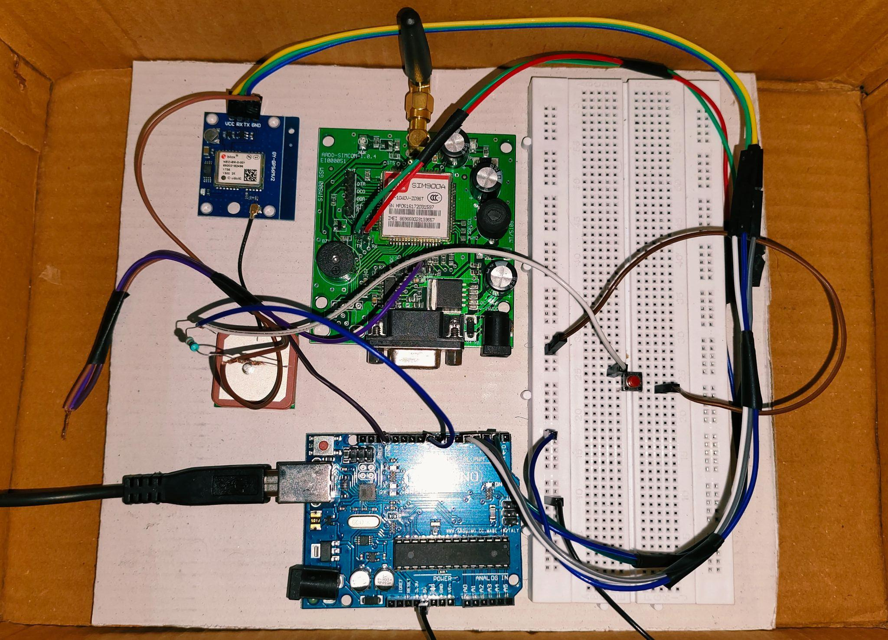
Hardware and Circuit Diagram

Slide 12
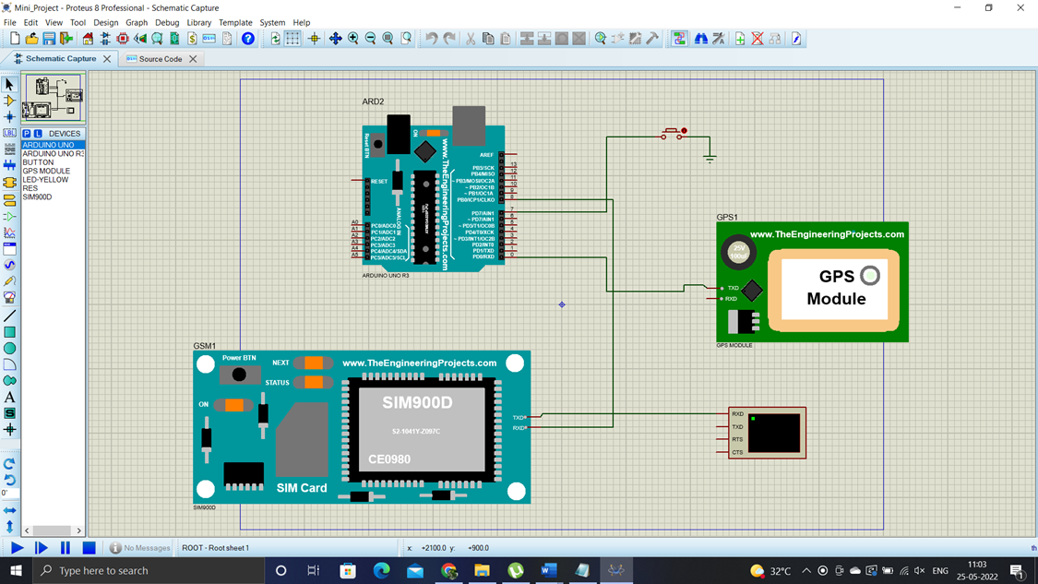
Circuit Diagram

Slide 13
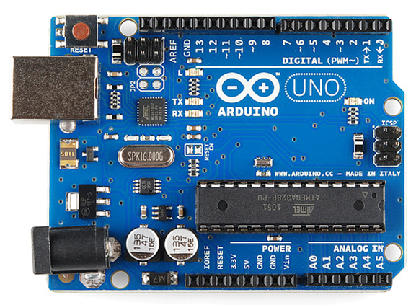
B) Component Specification
1) Arduino Uno R3
Arduino consists of both a physical programmable circuit board (often referred to as a microcontroller) and a piece of software, or IDE (Integrated Development Environment) that runs on your computer, used to write and upload computer code
Microcontroller: ATmega328P
Operating Voltage: 5V
Input Voltage (recommended): 7-12V
Input Voltage (limit): 6-20V
Digital I/O Pins: 20
Flash Memory: 32 KB
SRAM: 2 KB
EEPROM: 1 KB
LED_BUILTIN: 13
Weight: 25g

Slide 14
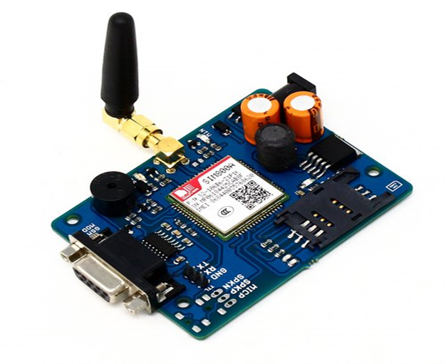
2) GSM Module
The SIM900A is a readily available
GSM/GPRS module, used in many mobile
phones and PDA.
Dimensions: 24x24x3mm
Weight: 3.4g
Control via AT commands
SIM application toolkit
Supply voltage: 12V, 2A
Operation temperature: -40°C to +85°C
Dual-Band 900/ 1800 MHz

Slide 15
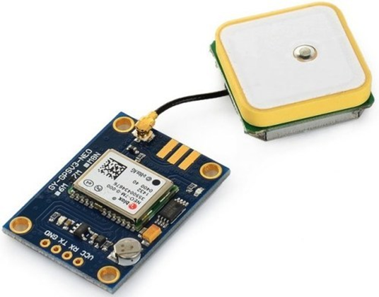
3) GPS Module
The NEO-6M GPS module is a well-performing complete GPS receiver which provides a strong satellite search capability
Receiver Type: 50 Channels, GPS L1(1575.42Mhz)
Navigation Sensitivity: -161dBm
TXD/RXD Impedance: 510Ω
Serial Baud Rate: 4800-230400 (default 9600)

Slide 16
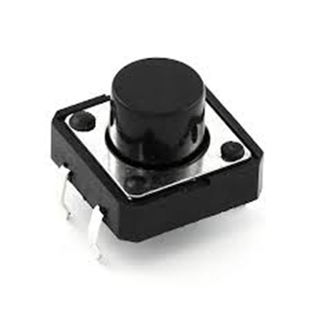
4) Push Button
Mode of Operation: Tactile feedback
Contact Resistance: MAX 100mOhm
Operating Temperature Range: -20 to +70 ℃
Storage Temperature Range: -20 to +70 ℃

Slide 17
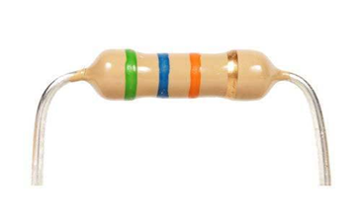
5) Resistor
A resistor is a passive two-terminal electrical component that implements electrical resistance as a circuit element.
resistors are used to reduce current flow, adjust signal levels, to divide voltages, bias active elements, and terminate transmission lines, among other uses.
Here, we have a carbon film axial leaded through hole type and can handle up to 1/4W of power at voltages up to 350V. 1/4W resistors are the most commonly used size for breadboarding.

Slide 18
Software
Proteus Professional v8.0
Proteus 8 Professional is a software which can be used to draw schematics, PCB layout, code and even simulate the schematic. It is developed by Labcenter Electronic Ltd.
Arduino.exe
The Arduino IDE is an open-source software, which is used to write and upload code to the Arduino boards. The IDE application is suitable for different operating systems such as Windows, Mac OS X, and Linux. It supports the programming languages C and C++.

Slide 19

Results:
A) Hardware

Slide 20
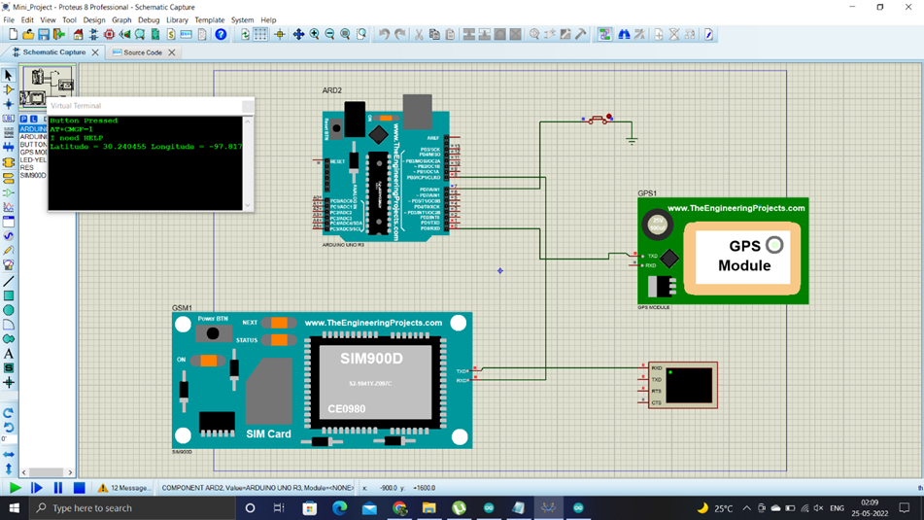
Proteus Output

Slide 21
Conclusion
This work attempts to keep women safe, it’s a portable device so it can be easily carried to any places. On one single press of the push button, a HELP message with the location coordinates and Google Map URL could be sent to registered numbers, due to which some essential action could be taken by the police administration and those contacts.

Slide 22
Advantages
Low use of wiring since the system requires less components.
Low cost, light in weight and robust. Message is received with 2-3 seconds.
Location Coordinates is received in the form Google Map’s URL so no other application would be needed for location to be detected.
Nowadays, Google Map is a default application in all smart phones.
Component Failure is very rare since, simple connections are done with separated power supplies.

Slide 23
Disadvantages
No protection feature is available in the proposed system.
Components are not latest in the proposed system, due to which few functionalities such as email, live tracking is not possible.

Slide 24
Future Scope
In Future, additional features can be added to the hardware like:
Camera and sound recorder so that live updates of user can be observed and recorded for future aspects as well as to provide better safety measures in case of danger.
And latest versions of hardware can be used to reduce the complexity and increase the performance as well as functionalities.
A dedicated android/web application can also be interfaced with the proposed system for better updates.
The proposed system may be turned automatic with the help of heartbeat sensor that would help in sending a message on drastic change in the heartbeat rate. Since, automatic may cause a false alarm therefore a cancellation button will help.

Slide 25
References
Papers:
1) J. Sunil Kumar, D. Sreelakshmi, G. Sindhura Bhargavi, “Women Safety System Using GSM & GPS Tracking”, Journal of Emerging Technologies and Innovative Research (JETIR) Volume-5 Issue-7, July 2018
2) B. Sathyasri, U. Jaishree Vidhya, G. V. K. Jothi Sree, T. Pratheeba, K. Ragapriya, “Design and Implementation of Women Safety System Based on Iot Technology”, International Journal of Recent Technology and Engineering (IJRTE) ISSN: 2277-3878, Volume-7 Issue-6S3, April, 2019
3) Dudyala Sunitha, Ms. Udayini Chandana, “Design And Implementation of Women Safety System Based on IoT Technologies”, Journal of Engineering Sciences (JES), Vol 10, Issue 9, Sept /2019
4) Ayesha Siddika, Md. Deluar Hussain, Md. Saddam Hossain, Md. Farhaduzzaman, “Analysis, Design and Development of Arduino Based Women Safety Device Using IoT”, International Journal of Advancements in Research & Technology (IJOART), Volume 7, Issue 9, September-2018
Links:-
1- https://www.theengineeringprojects.com/ : For installation of proteus modules
2- https://mechatrofice.com/arduino/send-gps-location-via-sms

